Slide 1
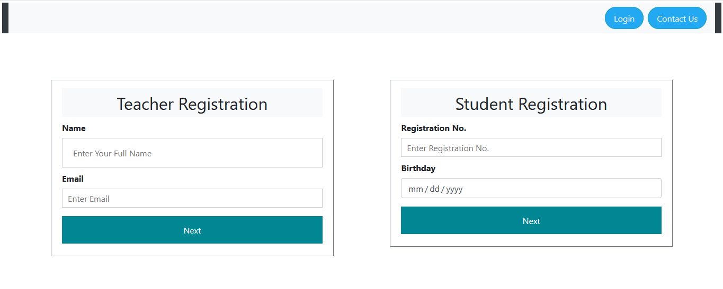
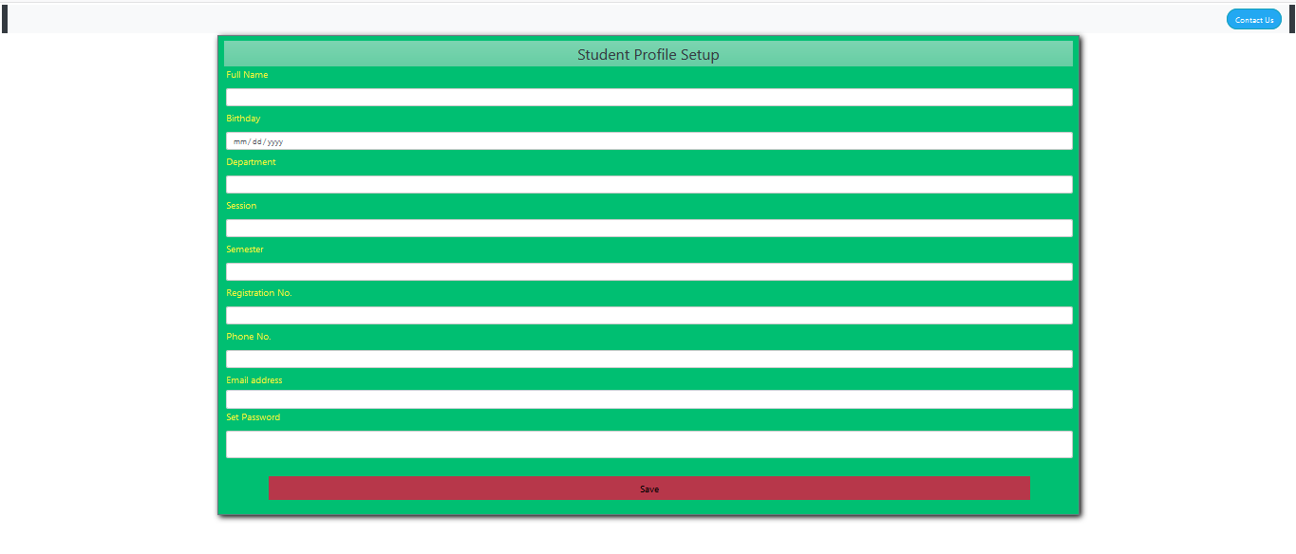
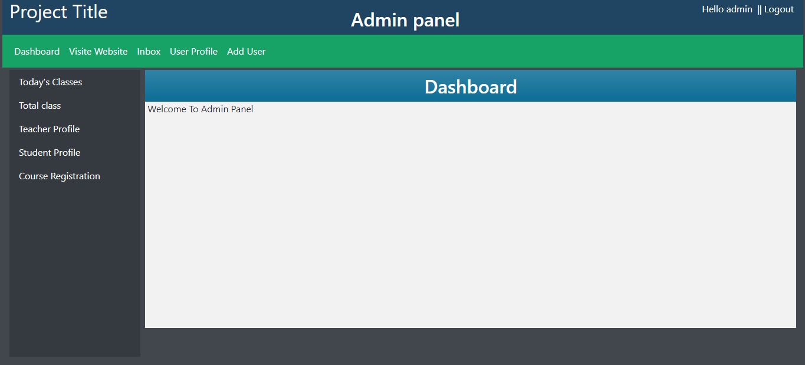
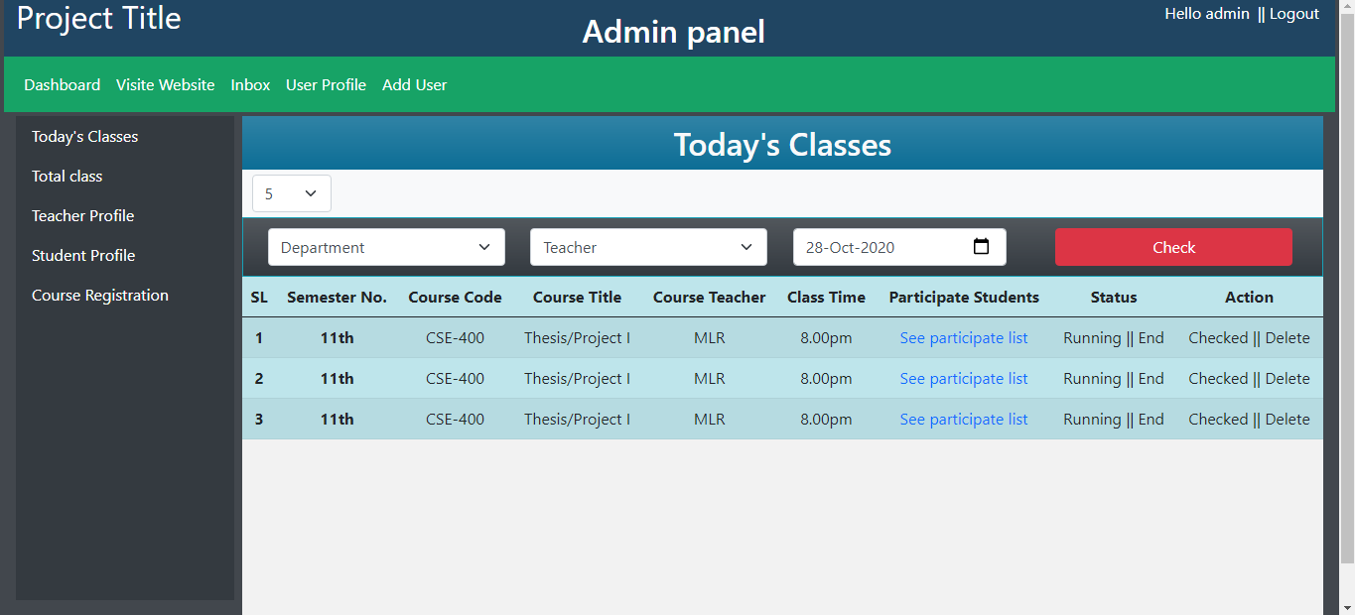
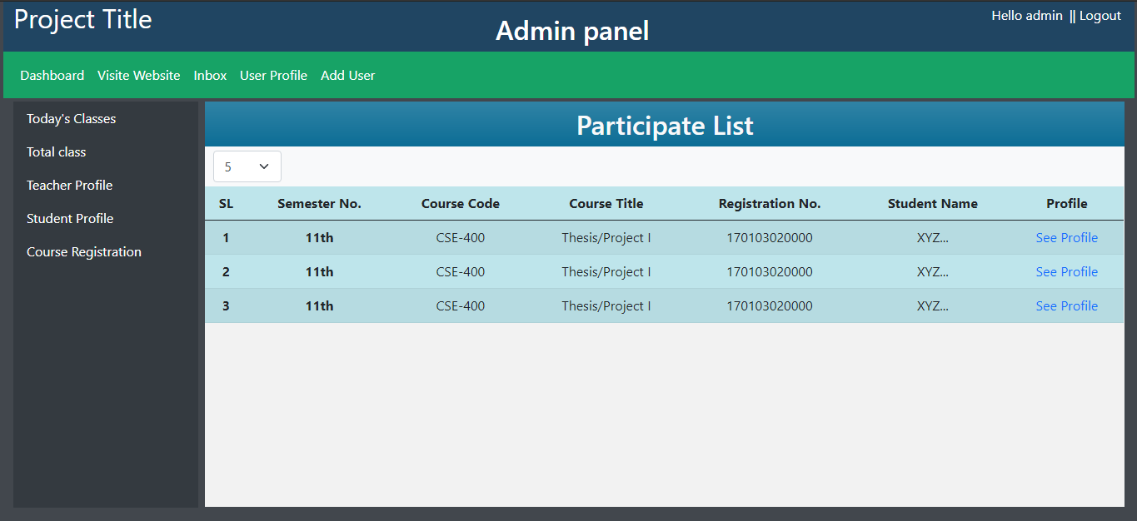
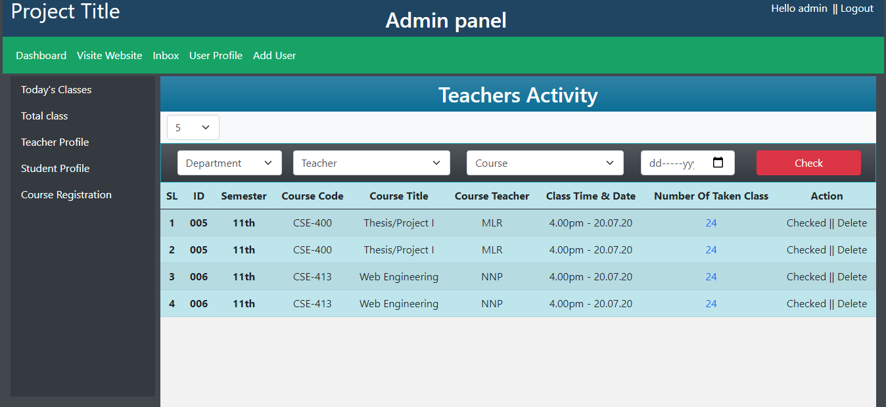
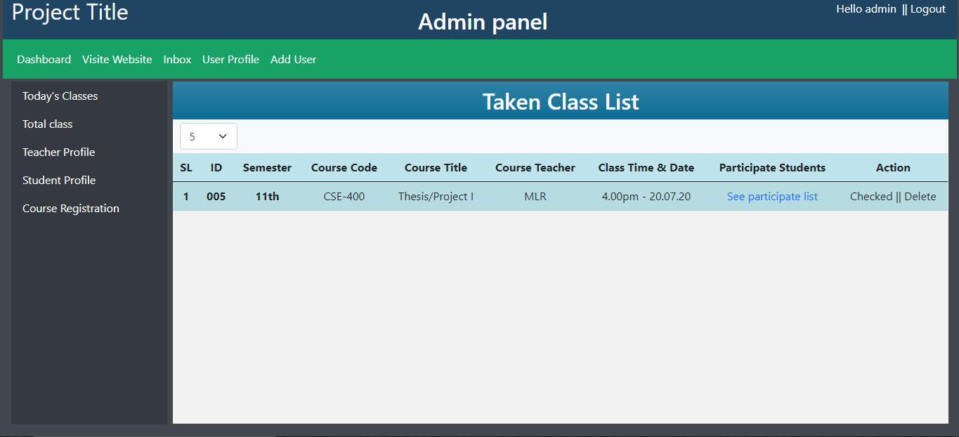
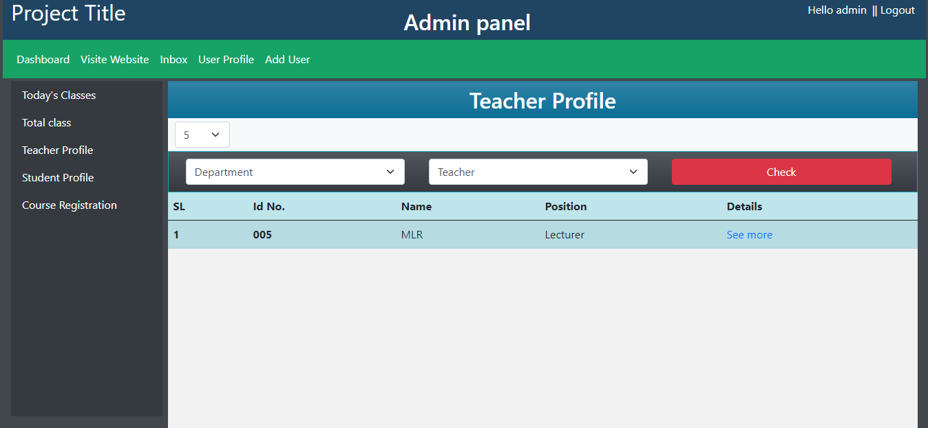
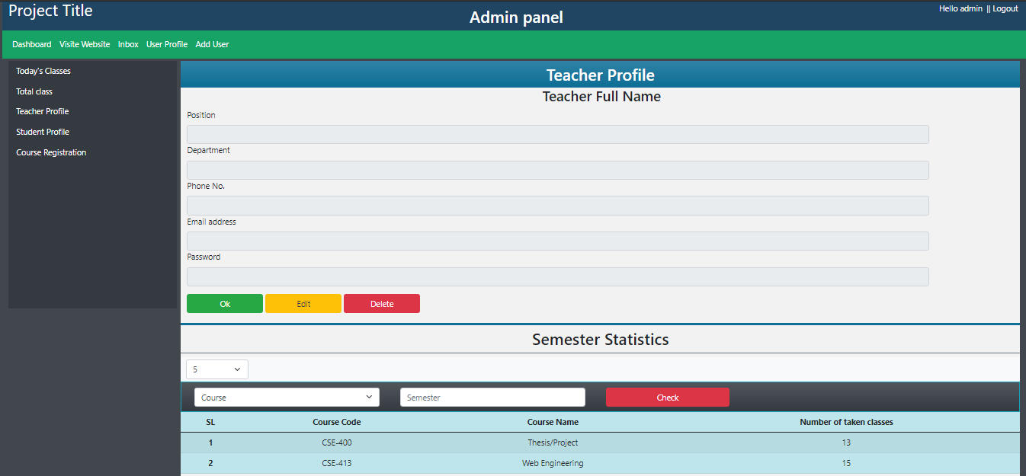
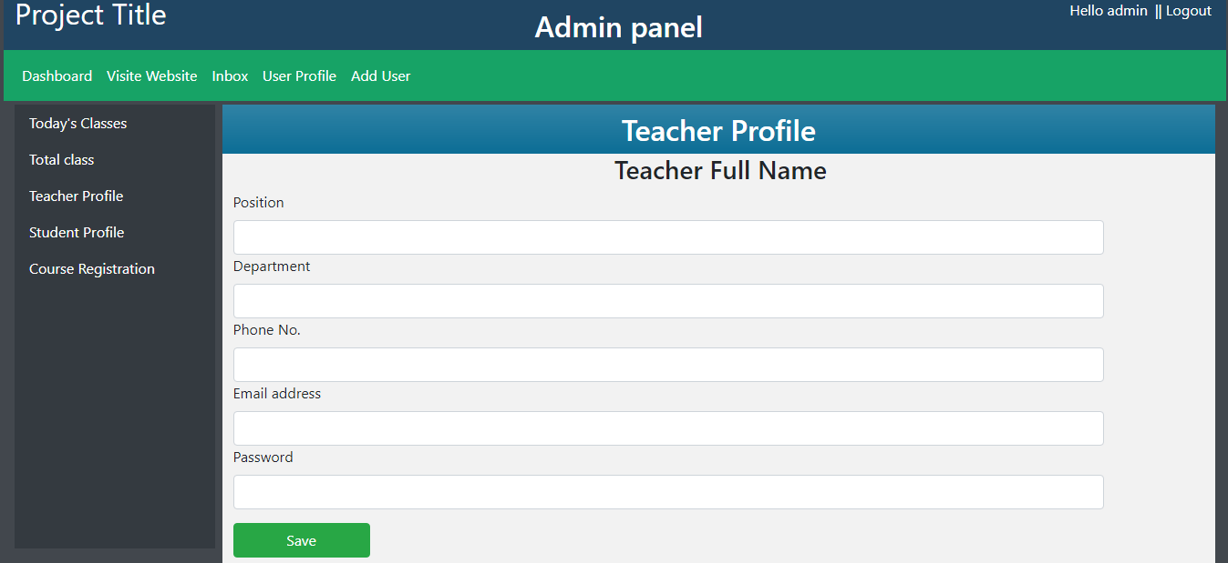
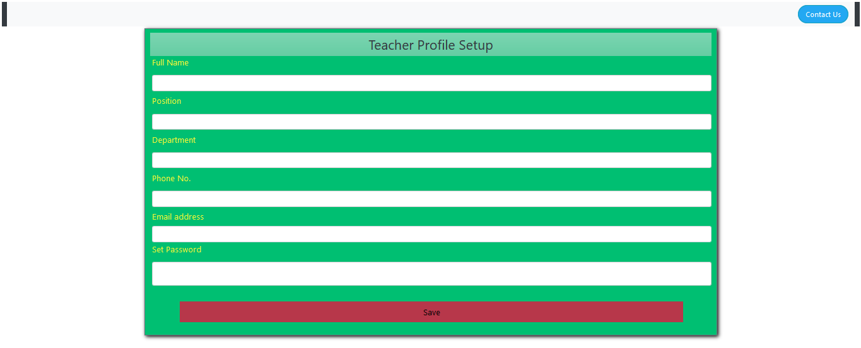
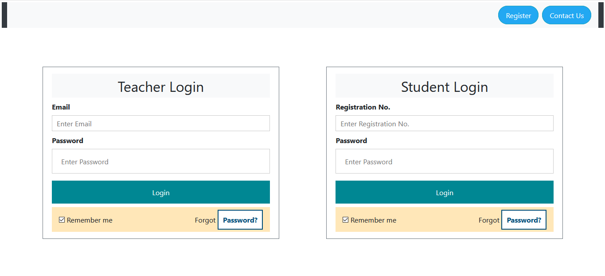
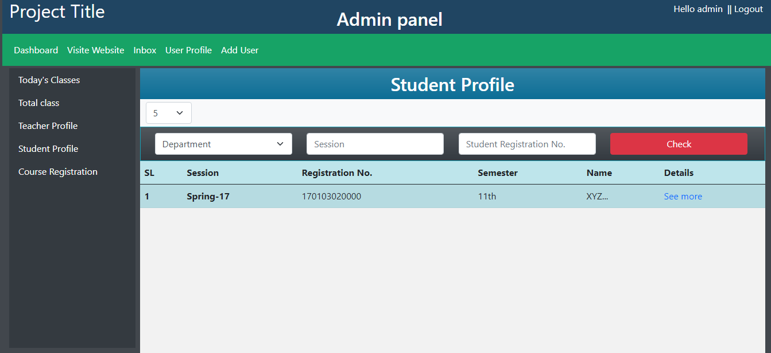
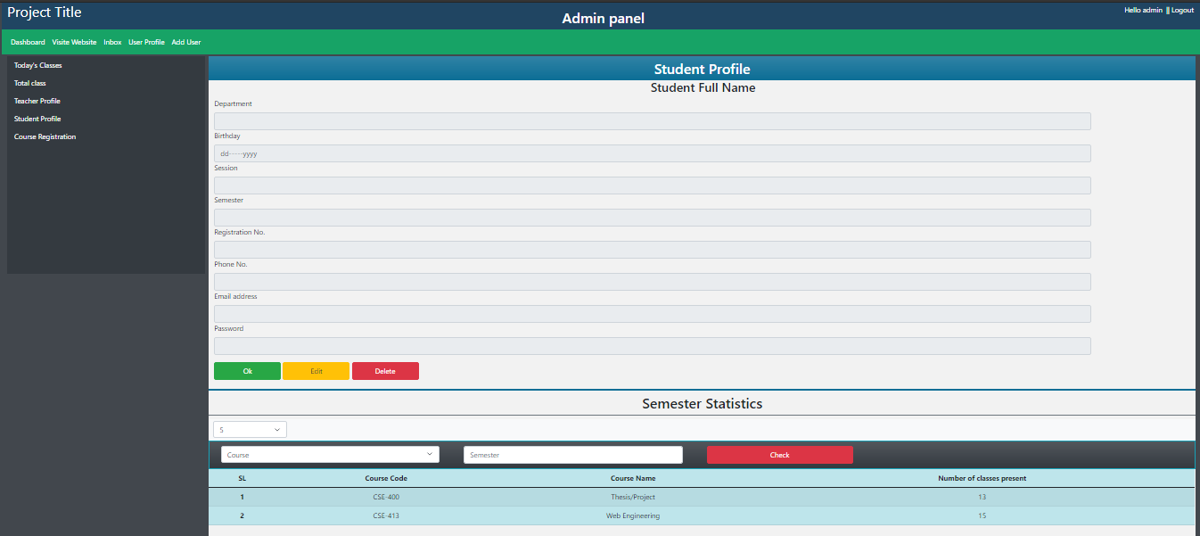
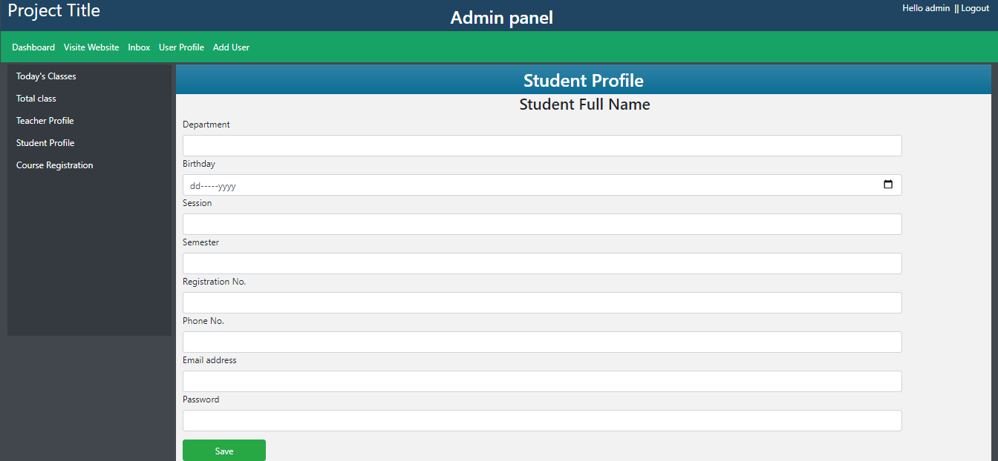
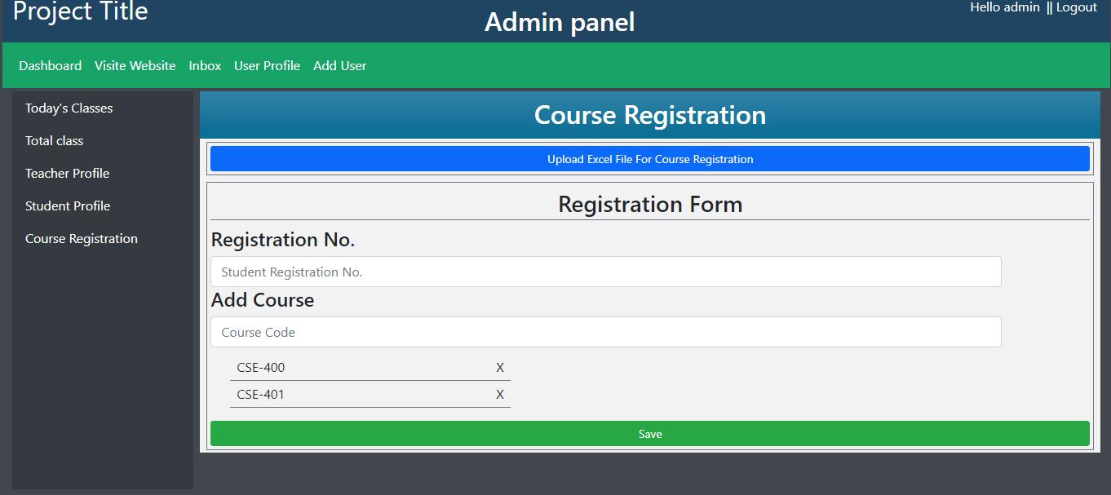
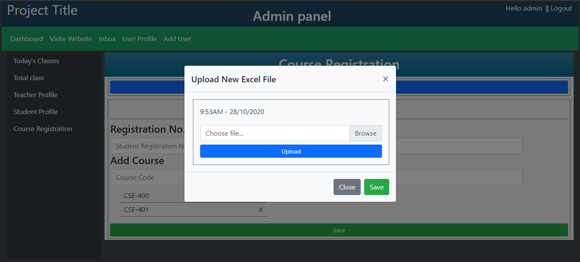
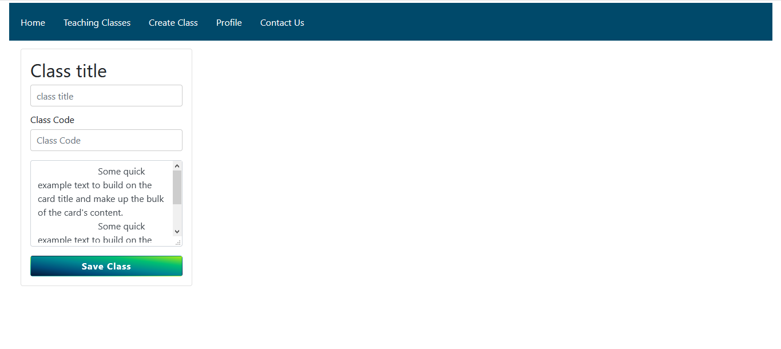
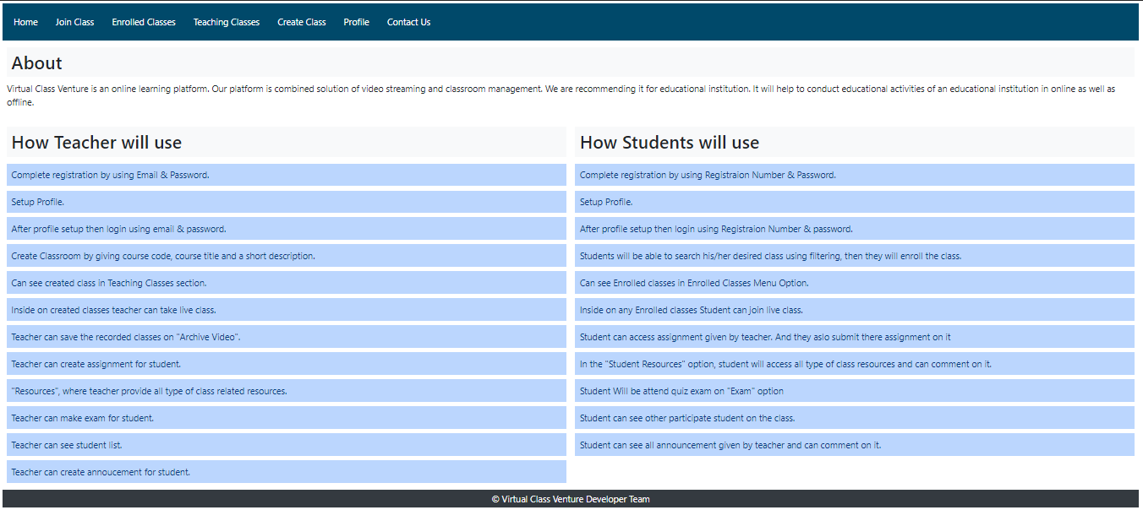
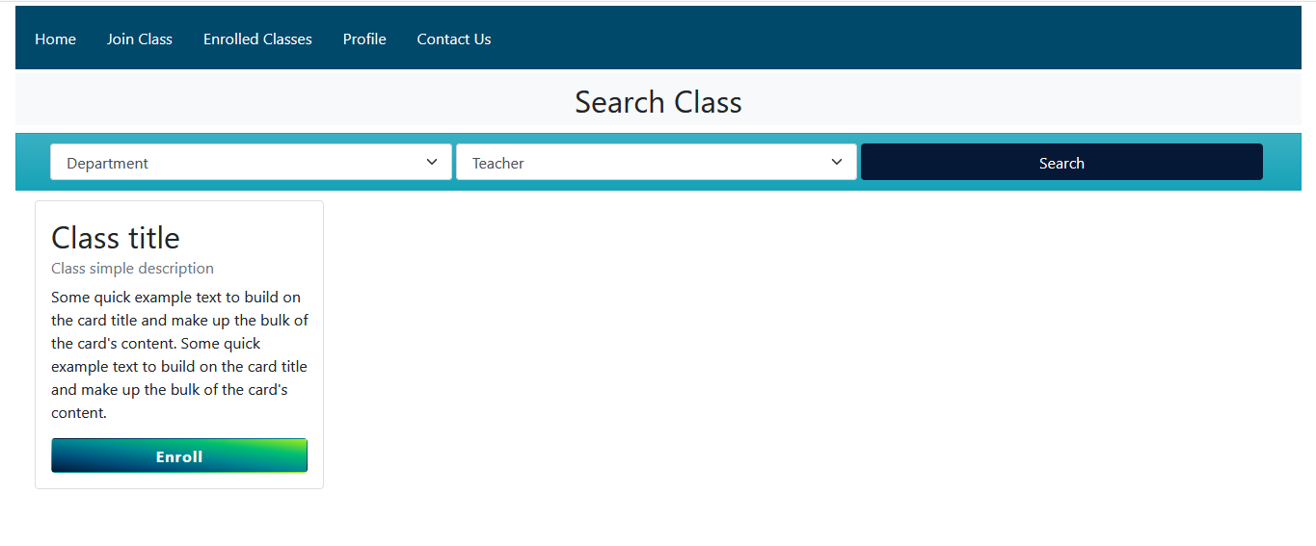
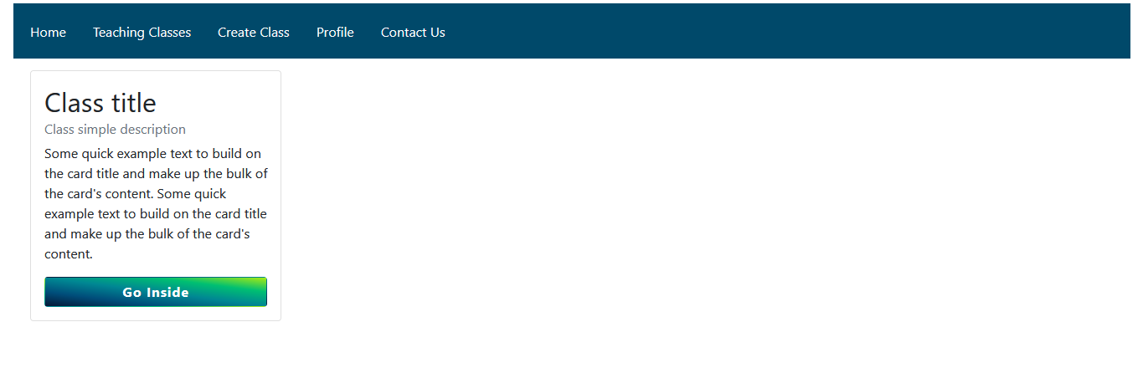
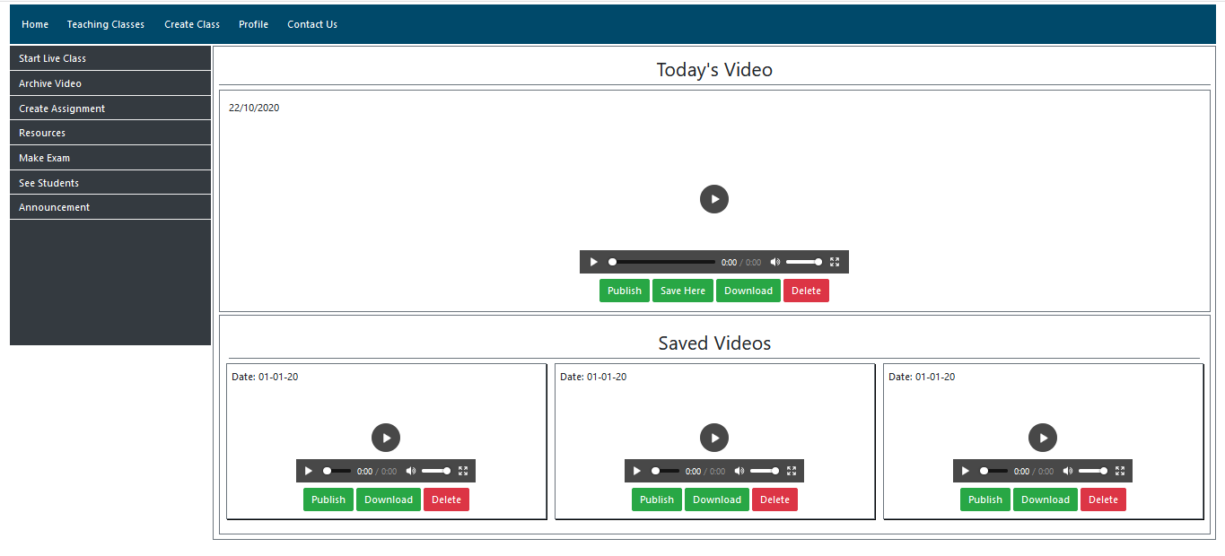
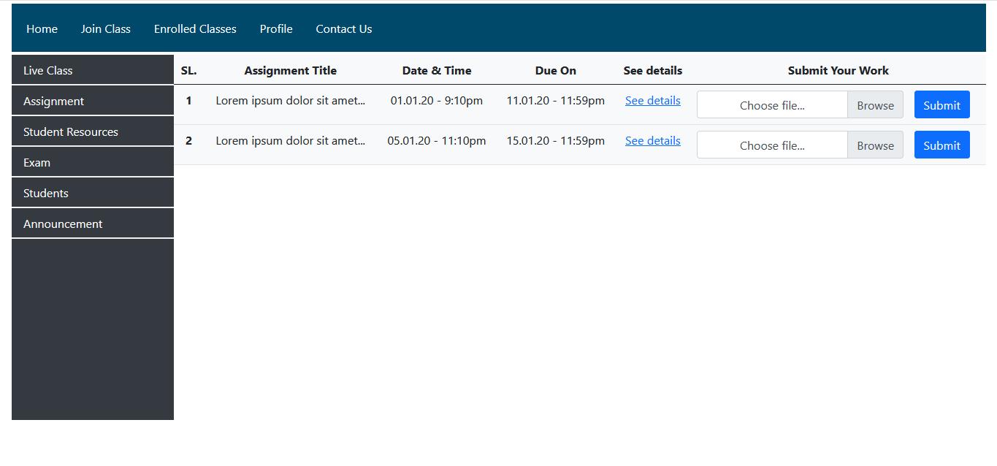
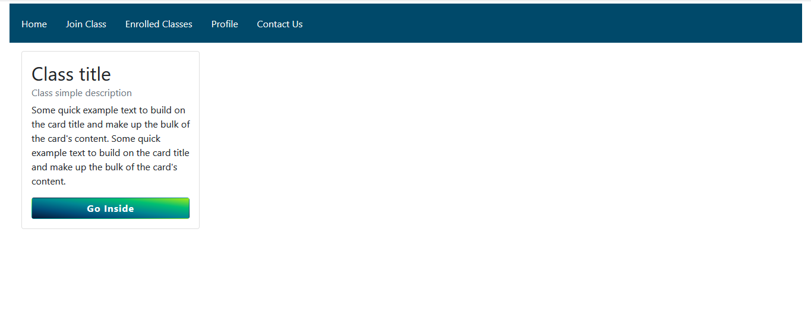
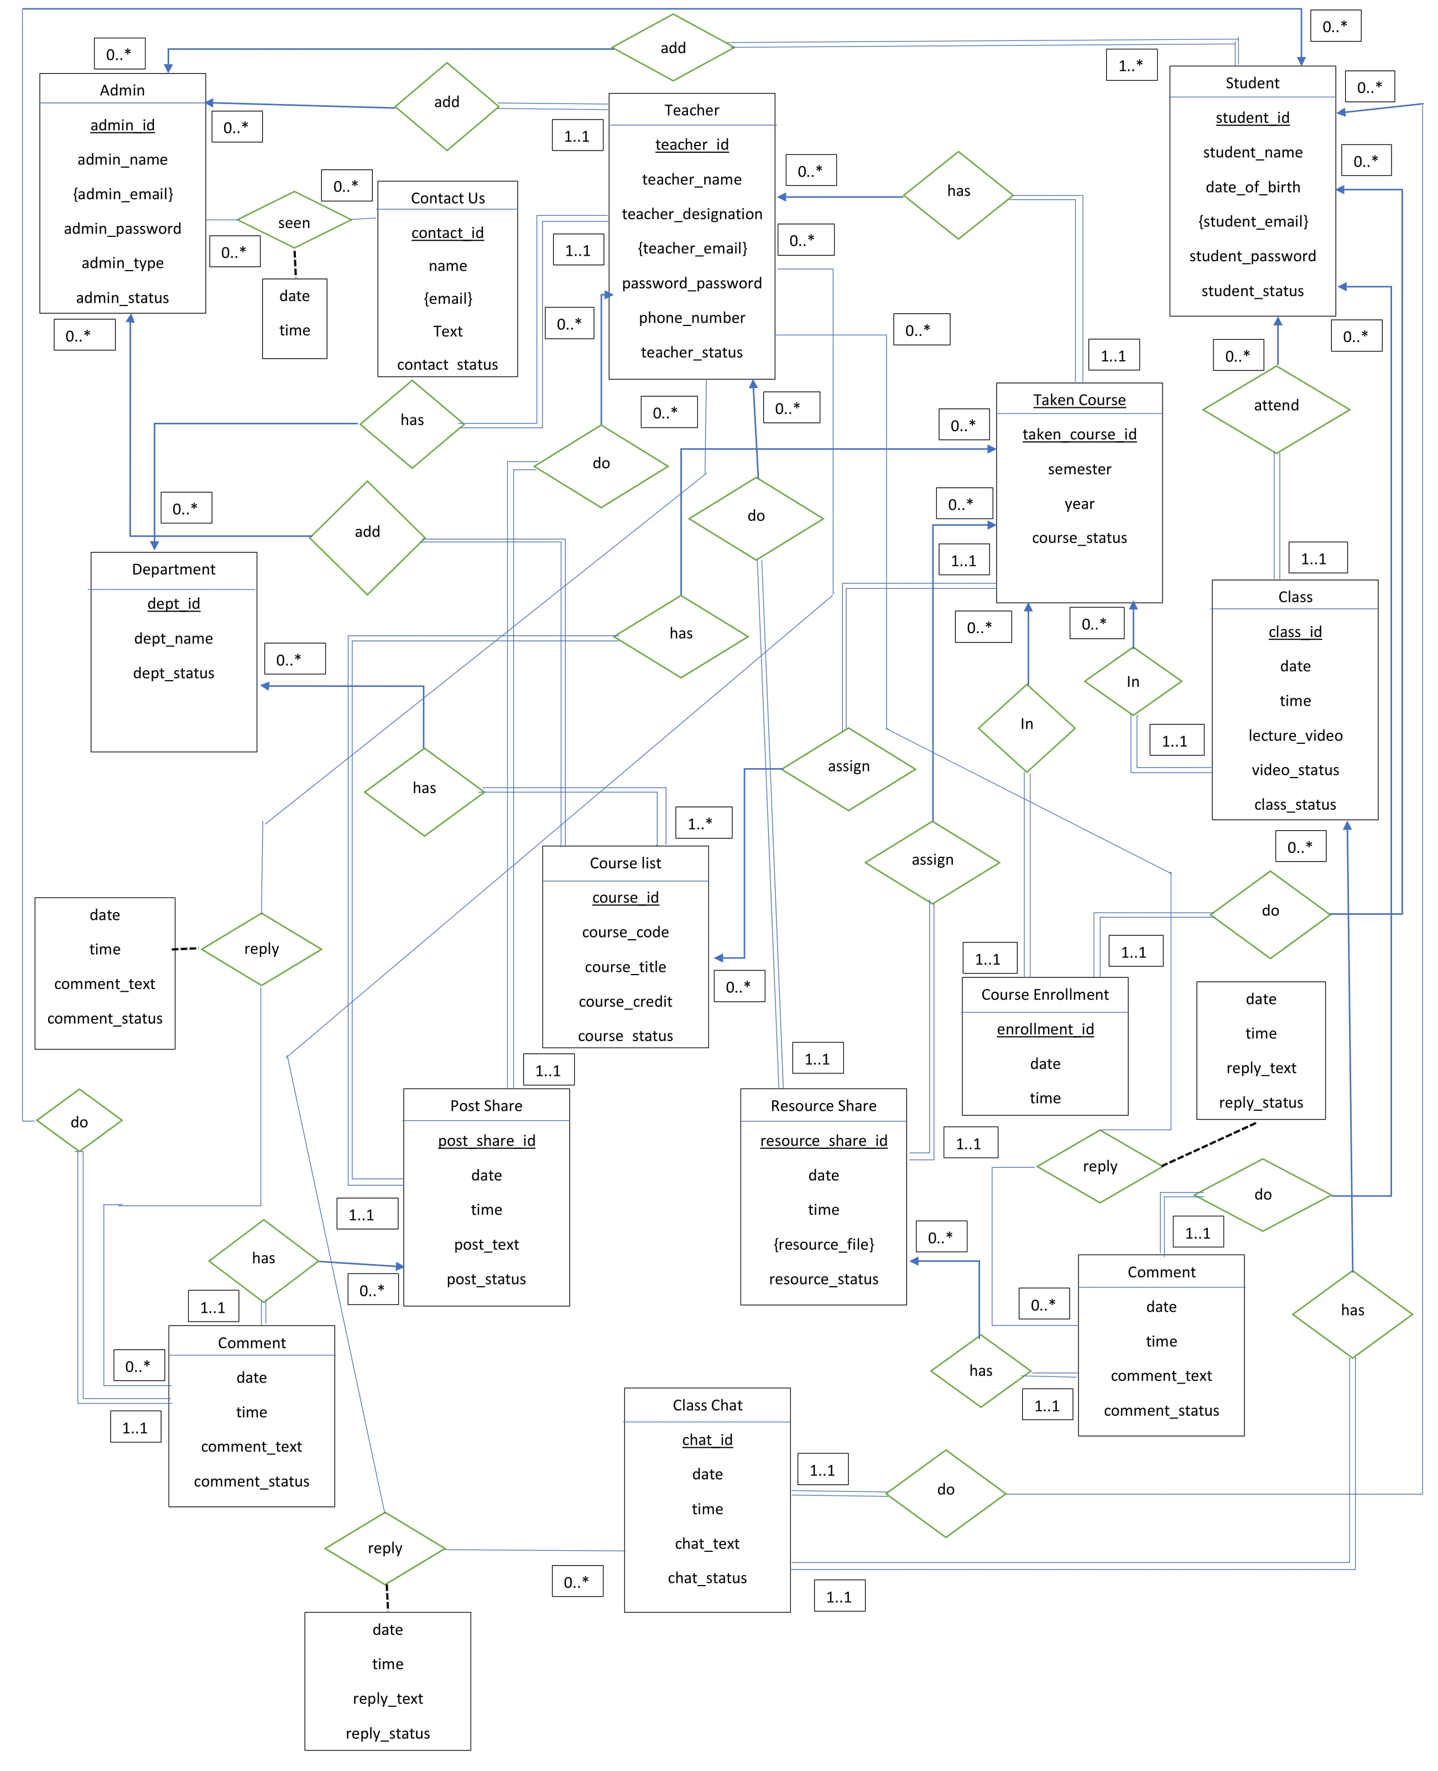
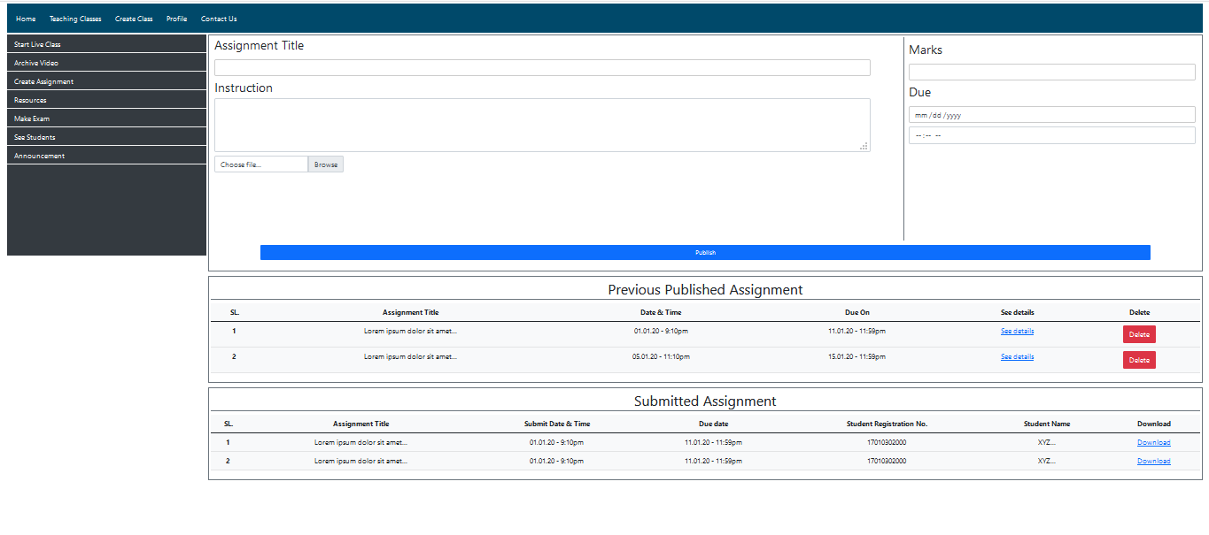
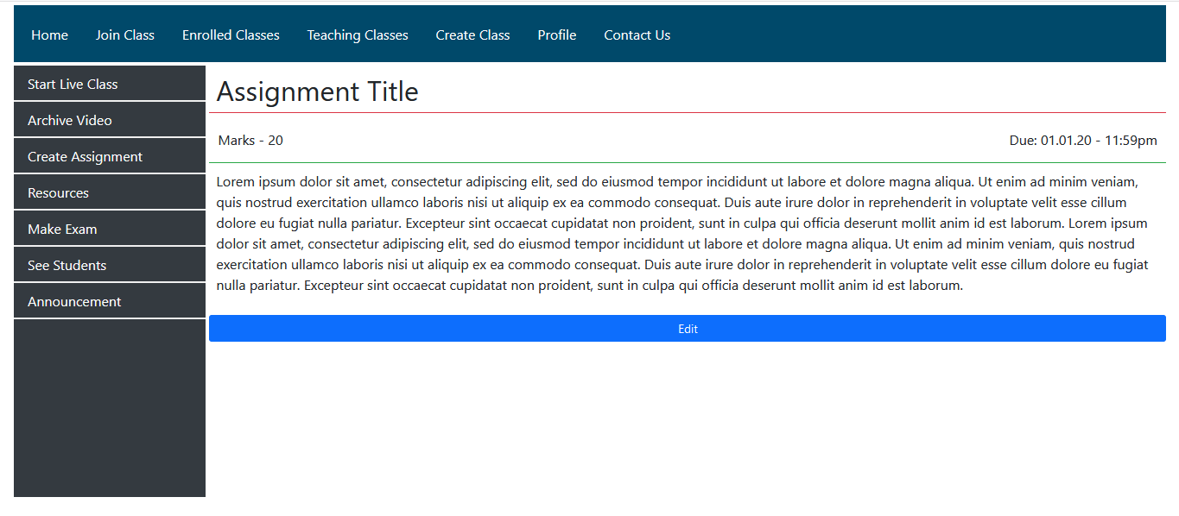
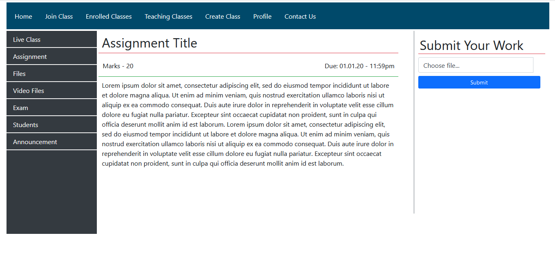
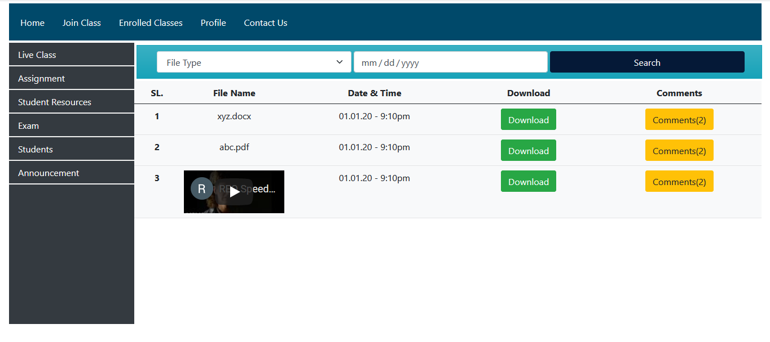
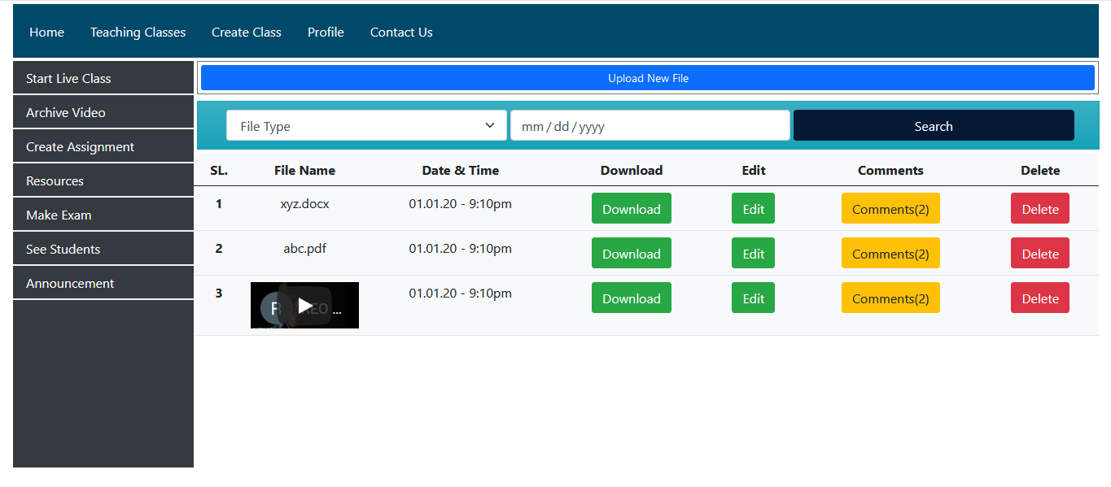
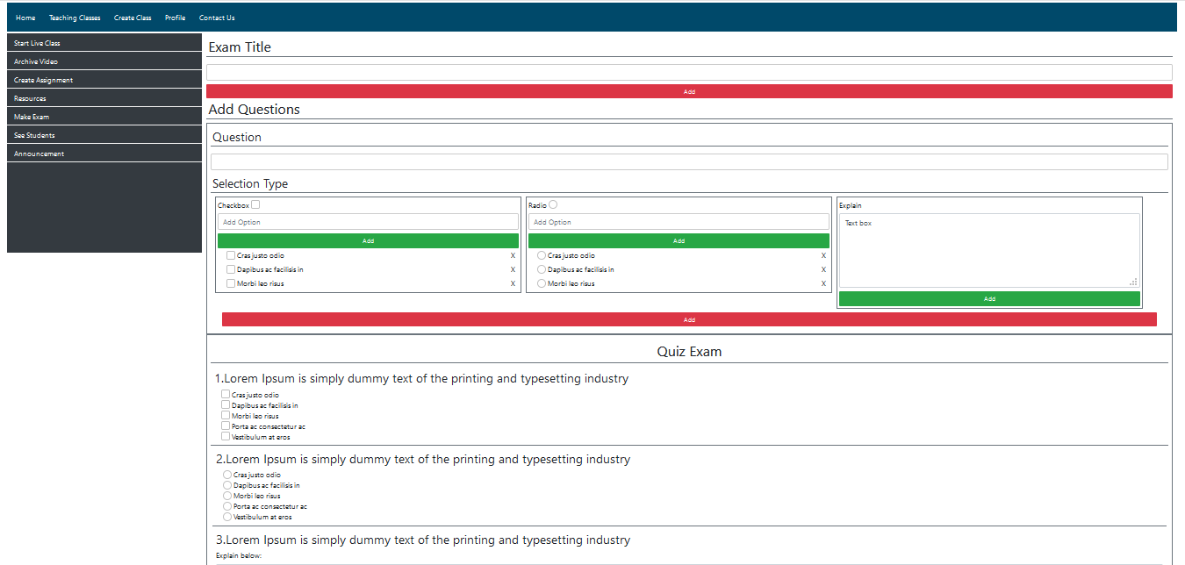
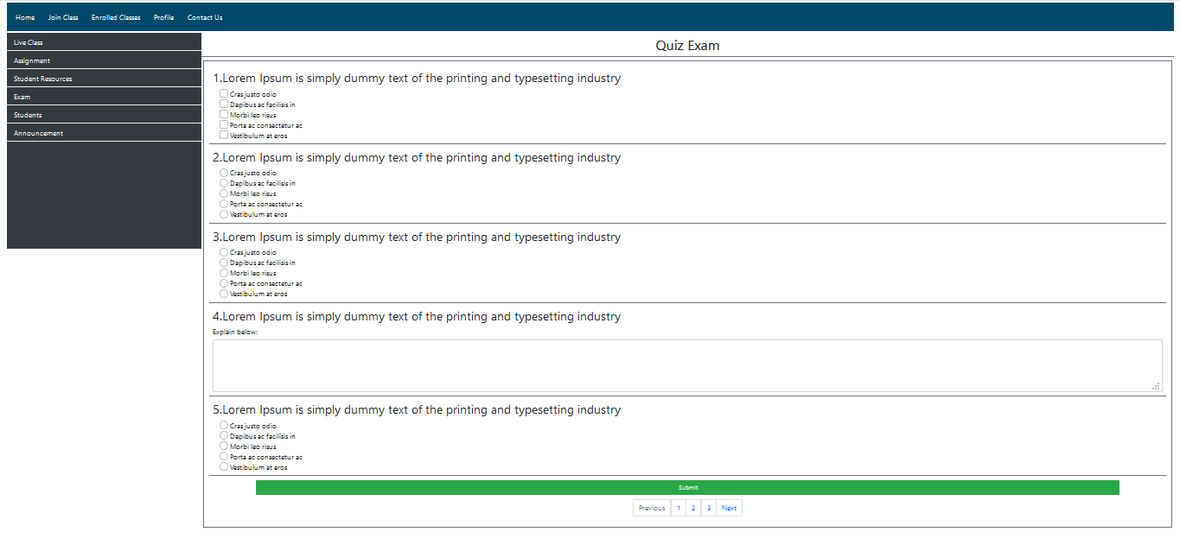
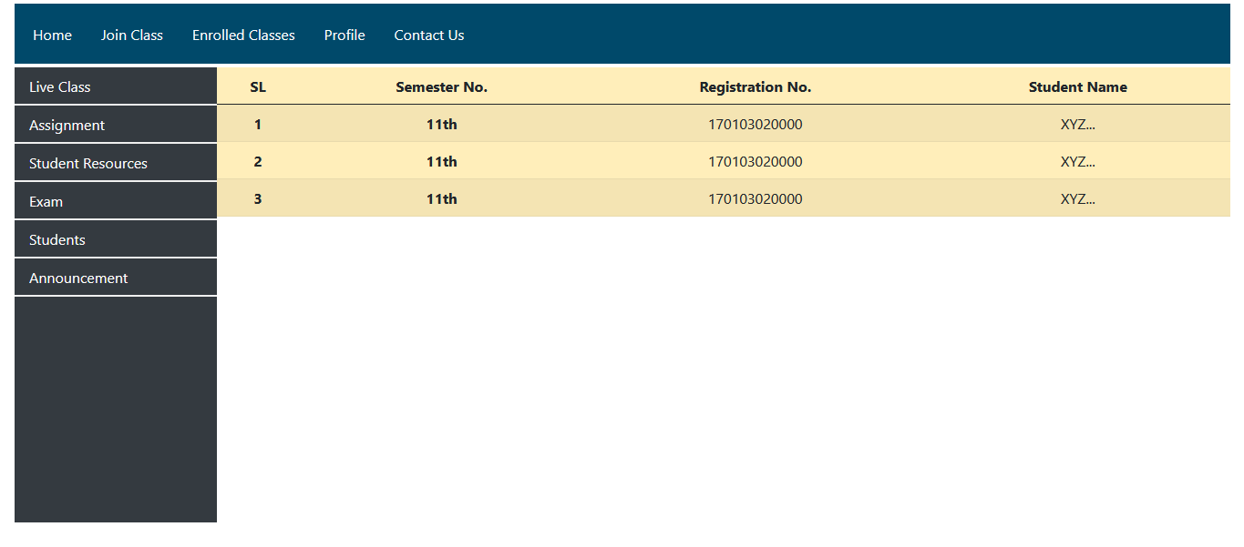
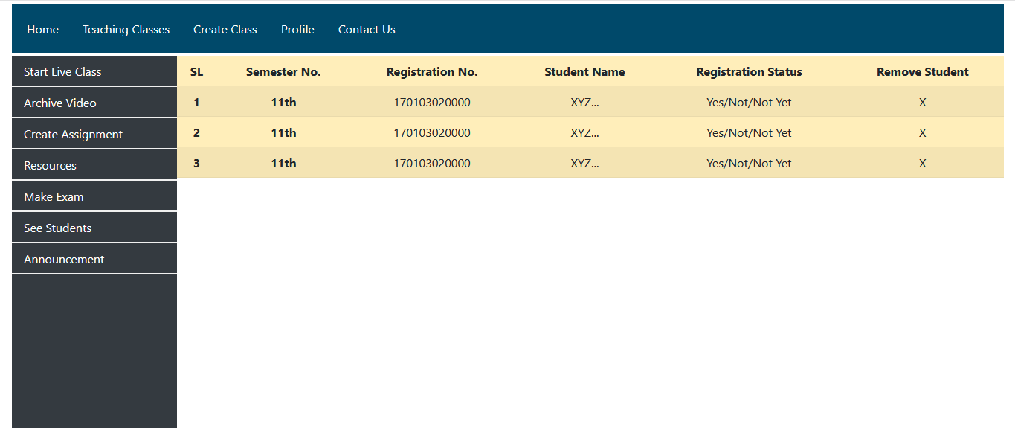
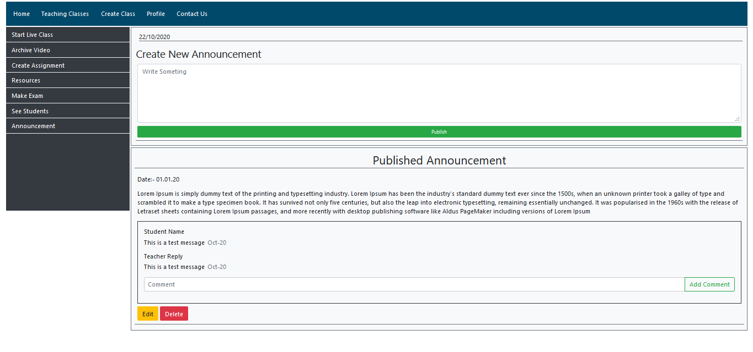
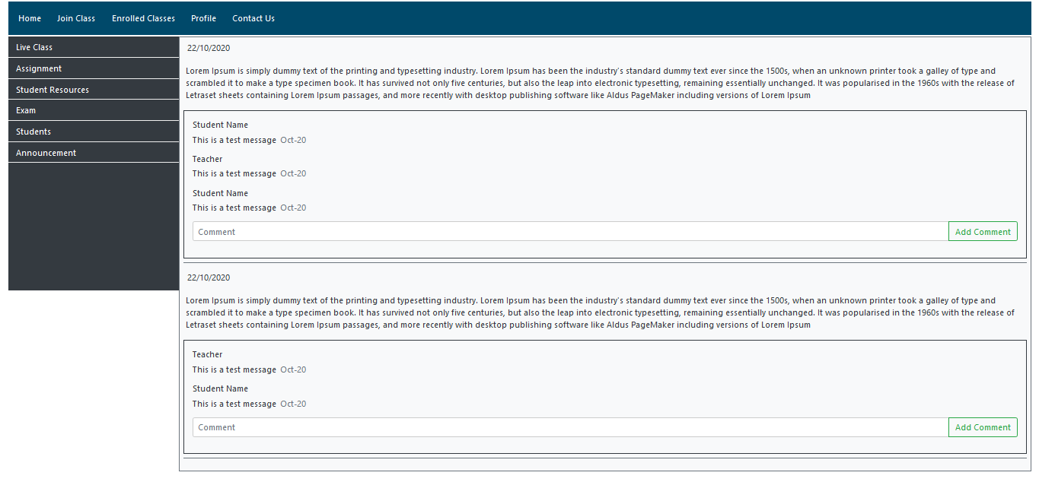
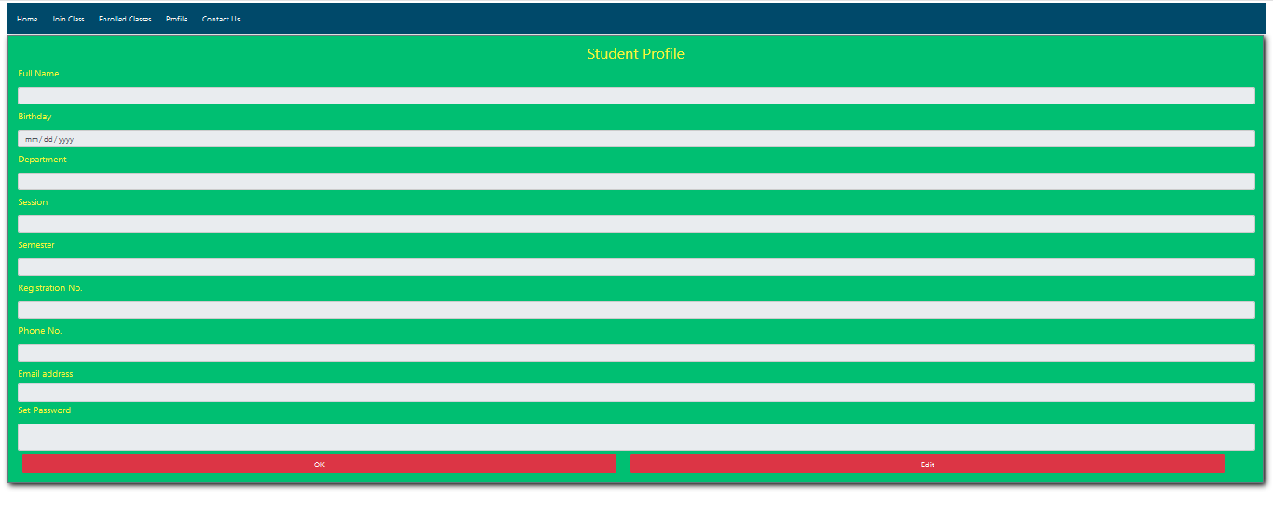
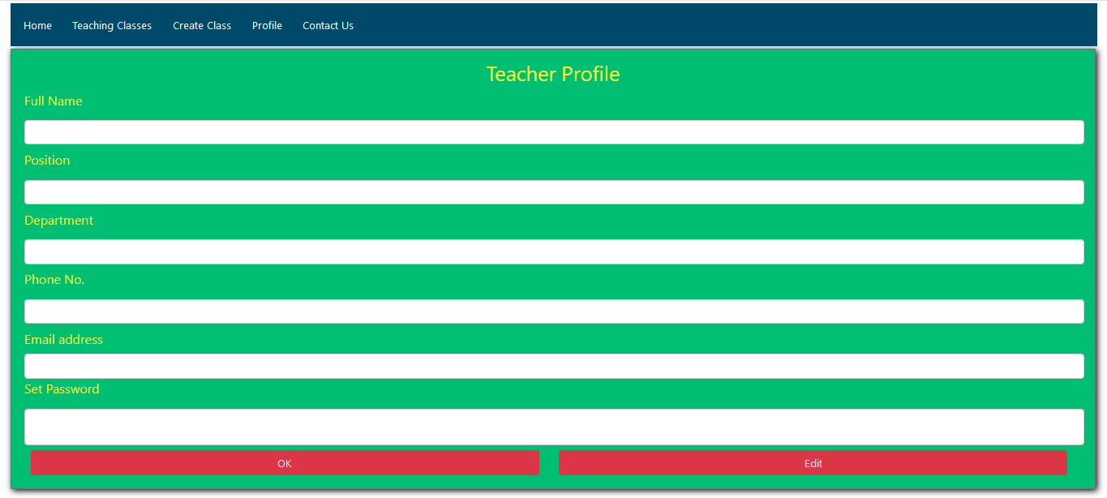
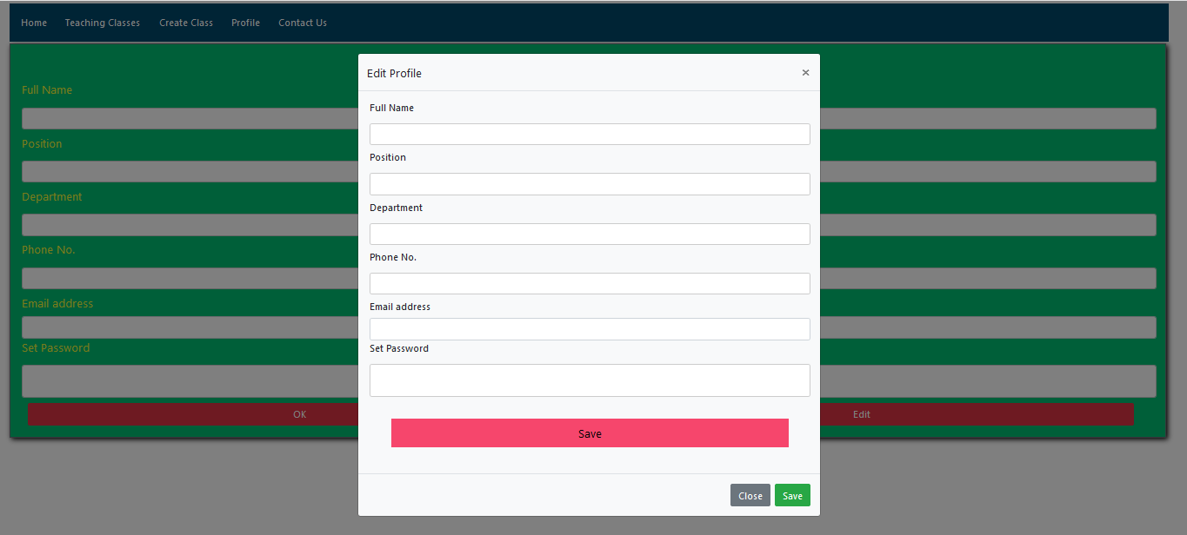
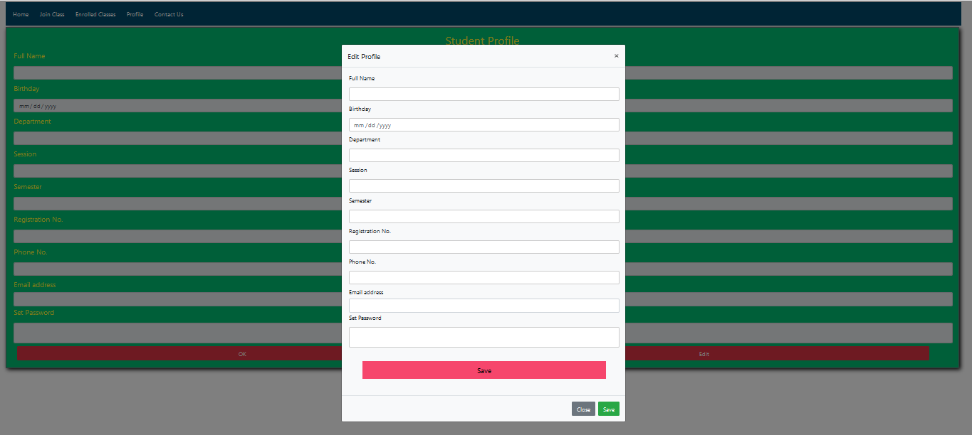
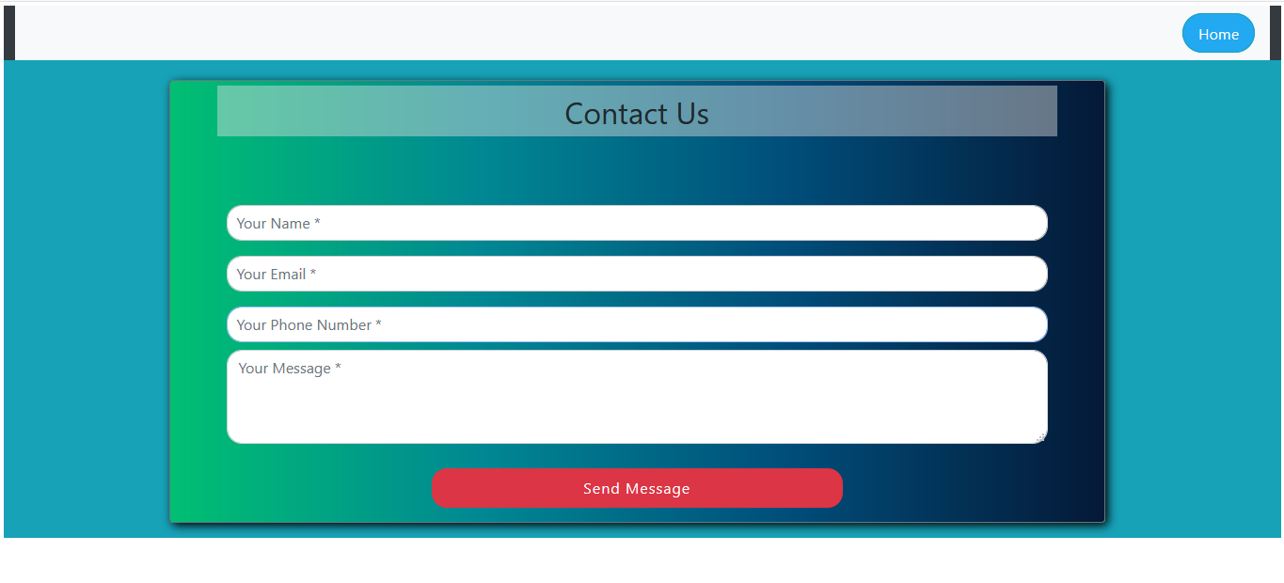
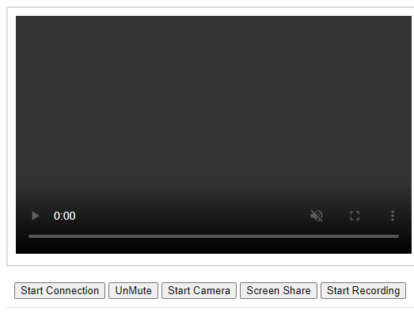
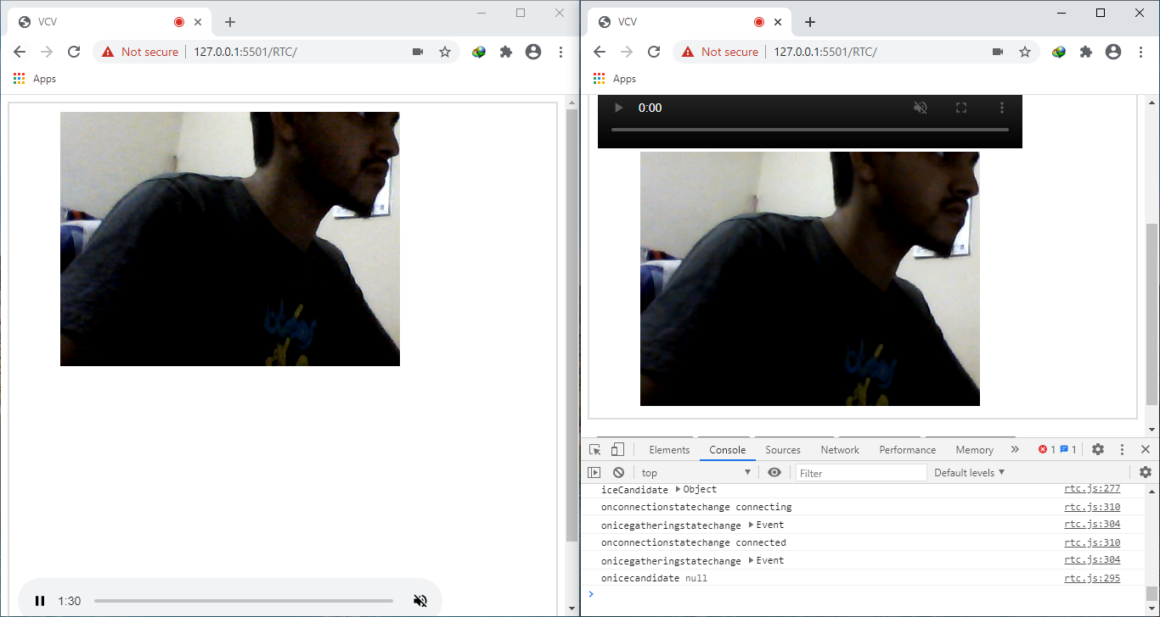
Virtual Class Venture for CSE 400 at 03.11.2020
Md. Asif Muntasir, ID: 170103020002, Email: asifmuntasirshuaib@gmail.com, Syed Nadir Ahmed, ID: 170103020010, Email: syednadirahmed2014@gmail.com
Proposed Main Features:
Our project main target is to create video streaming based on webrtc.
Screen controlling and Screen sharing while video streaming.
Audio mute/unmute option.
Chat between teacher and student while video streaming.
Record teacher’s activity during video streaming and save it on the system.
Teacher can see the student participate list.
Basic CRUD functionality (Profile create and maintenance by teacher and student).
Admin panel for monitoring teacher and student activities and also manage other admin activities.
Proposed Additional Features:
Basic CRUD functionality include file upload, download, delete etc.
Comment on post both teacher and student.
Teacher will be able to take attendance dynamically.
Teacher will be able to test student in quiz format.
Create announcement by teacher.
Teacher will be able to take assignment from student through the system.
For implementing WebRTC and all dynamic features we have used Node.js.
We have already used JavaScript to design some feature and we will continue it for future development.
For developing some features we have used jQuery and we will continue it for future development.
If an API is needed for project development, we will use it in the future.
User Interface Design:
Registration form
Admin Interface:
Admin Dashboard
Today Classes
Participate List
Teachers Activity
Student Profile Setup
Taken Class
Teacher Profile
Teacher Profile View
Teacher Profile Edit
Teacher Profile Setup
Teacher Login
Student Login
Student Profile
Student Profile View
Student Profile Edit
Course Registration Manually
Course Registration With CSV File
Create Class
Home Page
Join Class
Teaching Class
Archive Video
Assignment Submission
Enrolled Class
Works Done:
We have completed our frontend.
We know that RTC is a big concept. Due to time constraints we have only done the work of one to one connection.
We have completed our project ERD.
Future Work:
We want to complete WebRTC related work which is included in the main features.
If we get enough time, then we will complete our additional some features.
Contribution:
Nadir has done frontend of our project.
Asif has done a part of WebRTC which is our main feature of project.
Other project related work like as ER Diagram, report writing, poster design, requirement analysis and gathering, background study have been done by both.
We both understood every single line of code there is in the project whether it is frontend, RTC and ER Diagram.
ER Diagram:
Create Assignment
Assignment Details
Assignment Details for Student
Student Resources
Resources
Make Exam
Student Exam Paper
Student Participate List
Participate Student List
Create Announcement
Get Announcement
Student Profile
Teacher Profile
Teacher Profile Edit
Student Profile Edit
This is a general contact page. This can be used by both the student and the teacher for any query to the admin.
RTC Interface:
This is the initial stage of live class before class started.
Tools that we planned to use:
We have used Bootstrap5 (Alpha) version for designing webpages with some custom CSS.
In future we will use MySQL for database.
When host click on the ‘Start Connection’ button it will be connected with user. But before connect user have to answer the confirmation message. Here we only done one to one connection.
Supervised by: Mir Lutfur Rahman

